Slide 1




Industry Insider
Data Mining
Troy White, Justin Session, Savada Wilson

Slide 2
Introduction & Modus Operandi

Slide 3
What is the Purpose?
The purpose of our project can be summarized as a Data Mining initiative that provides tangible value to the professionals of the Music Industry. Our project provides this value as a digital fortune teller that's able to make accurate predictions about: trends in the market-share of genres of music, potential revenue of established artists and new acts. One might asks what are the advantages of using Data Mining to achieve these goals when positions already exist among conglomerates that fulfill this role? As a rebuttal, an algorithm unlike a machine, people have inescapable bias that in this case could lead to overestimating or underestimating the potential of a genre or artist. Additionally, the time required for a human to make a accurate assessment could take an entire quarter of a year, by this time a lot of opportunity loss has occurred. In comes the advanced models implemented in our program, working in tandem with an semi-automatic preprocessor that produces pristine datasets to mine with.

Slide 4
Use Case Diagrams

Slide 5
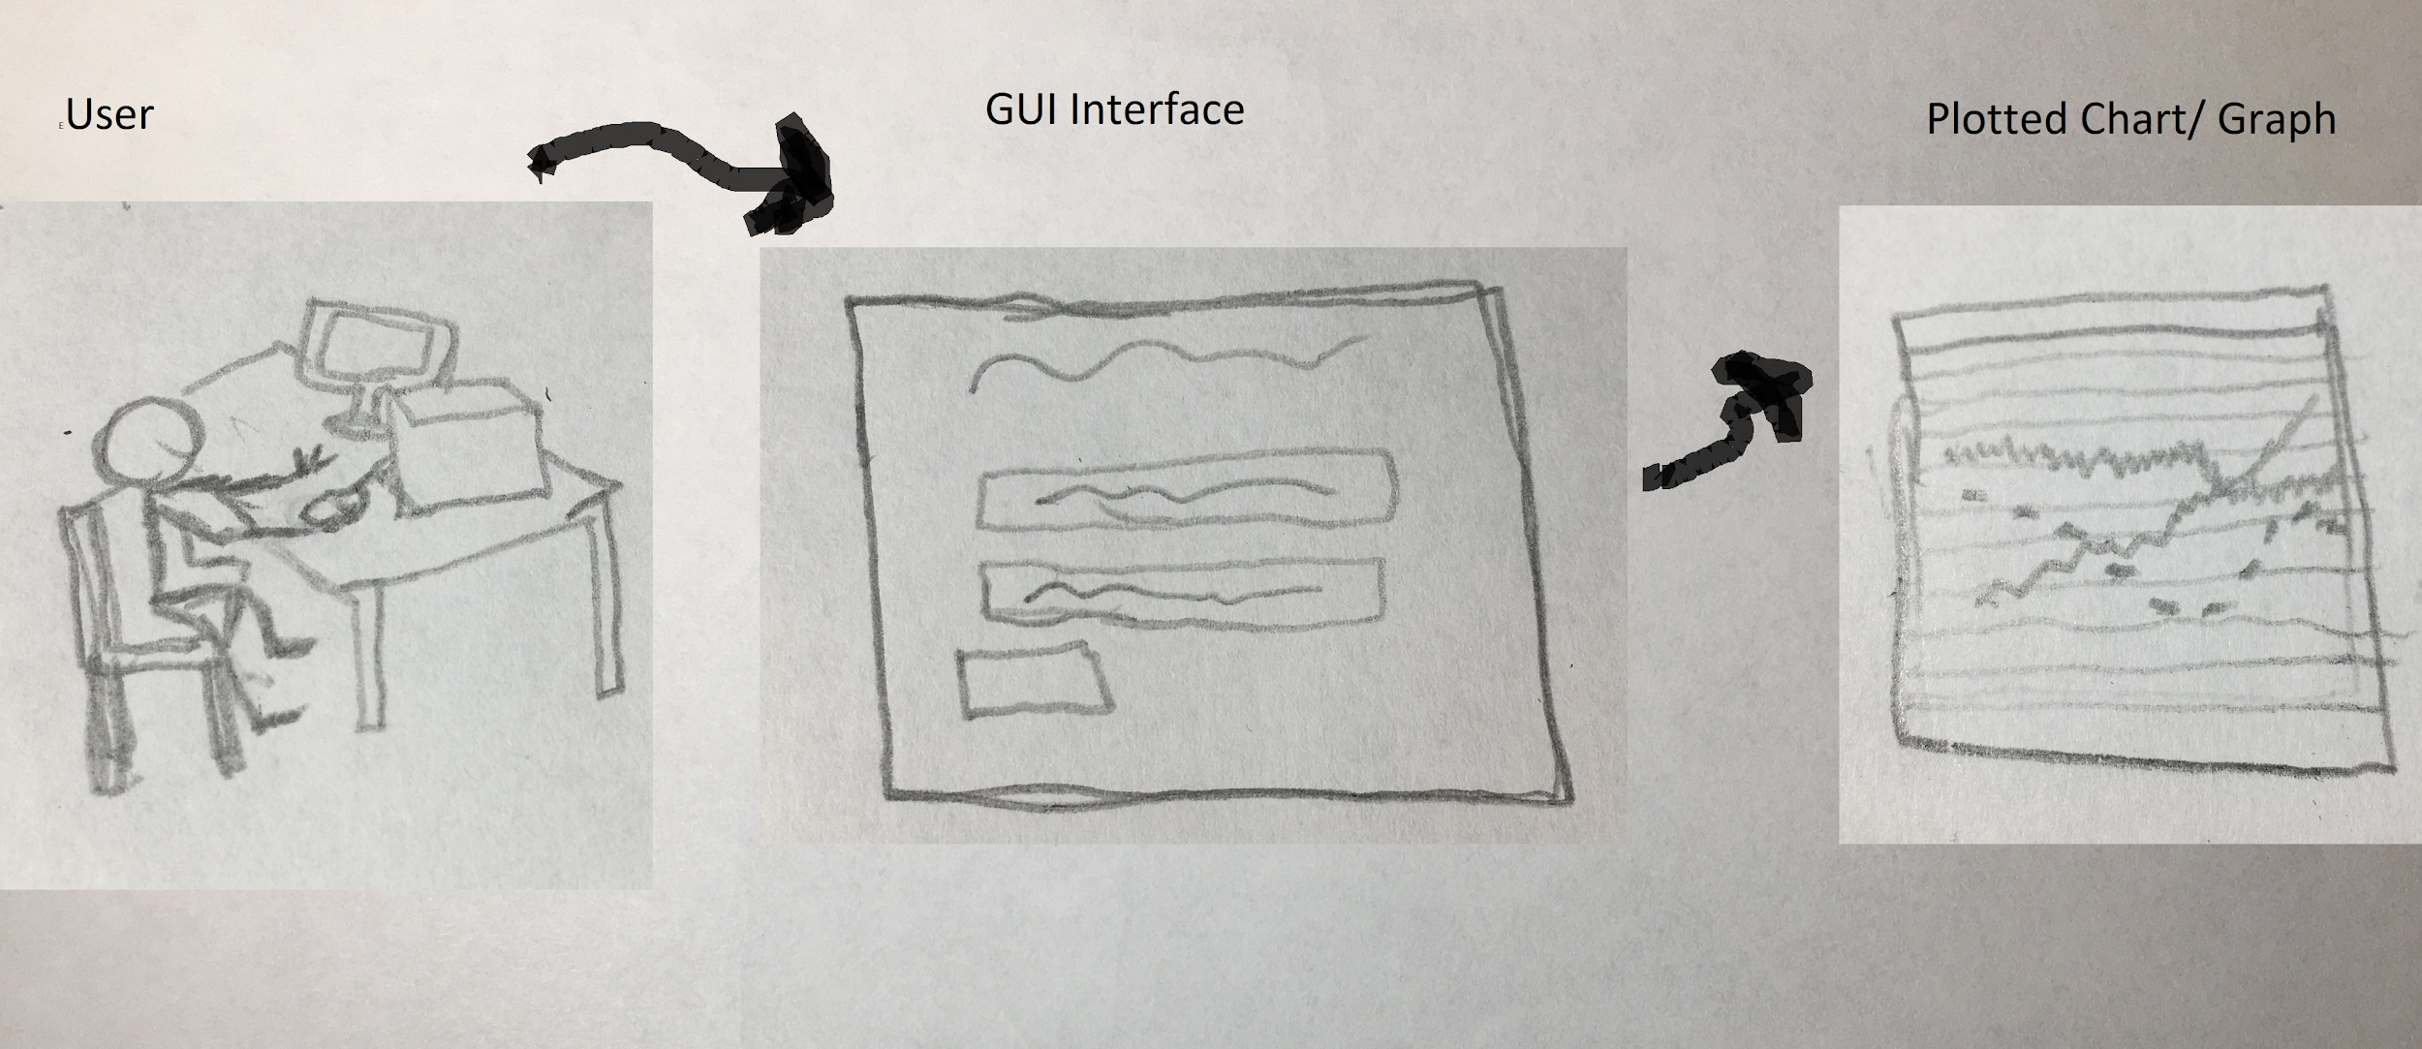
Use Case Diagram

Slide 6
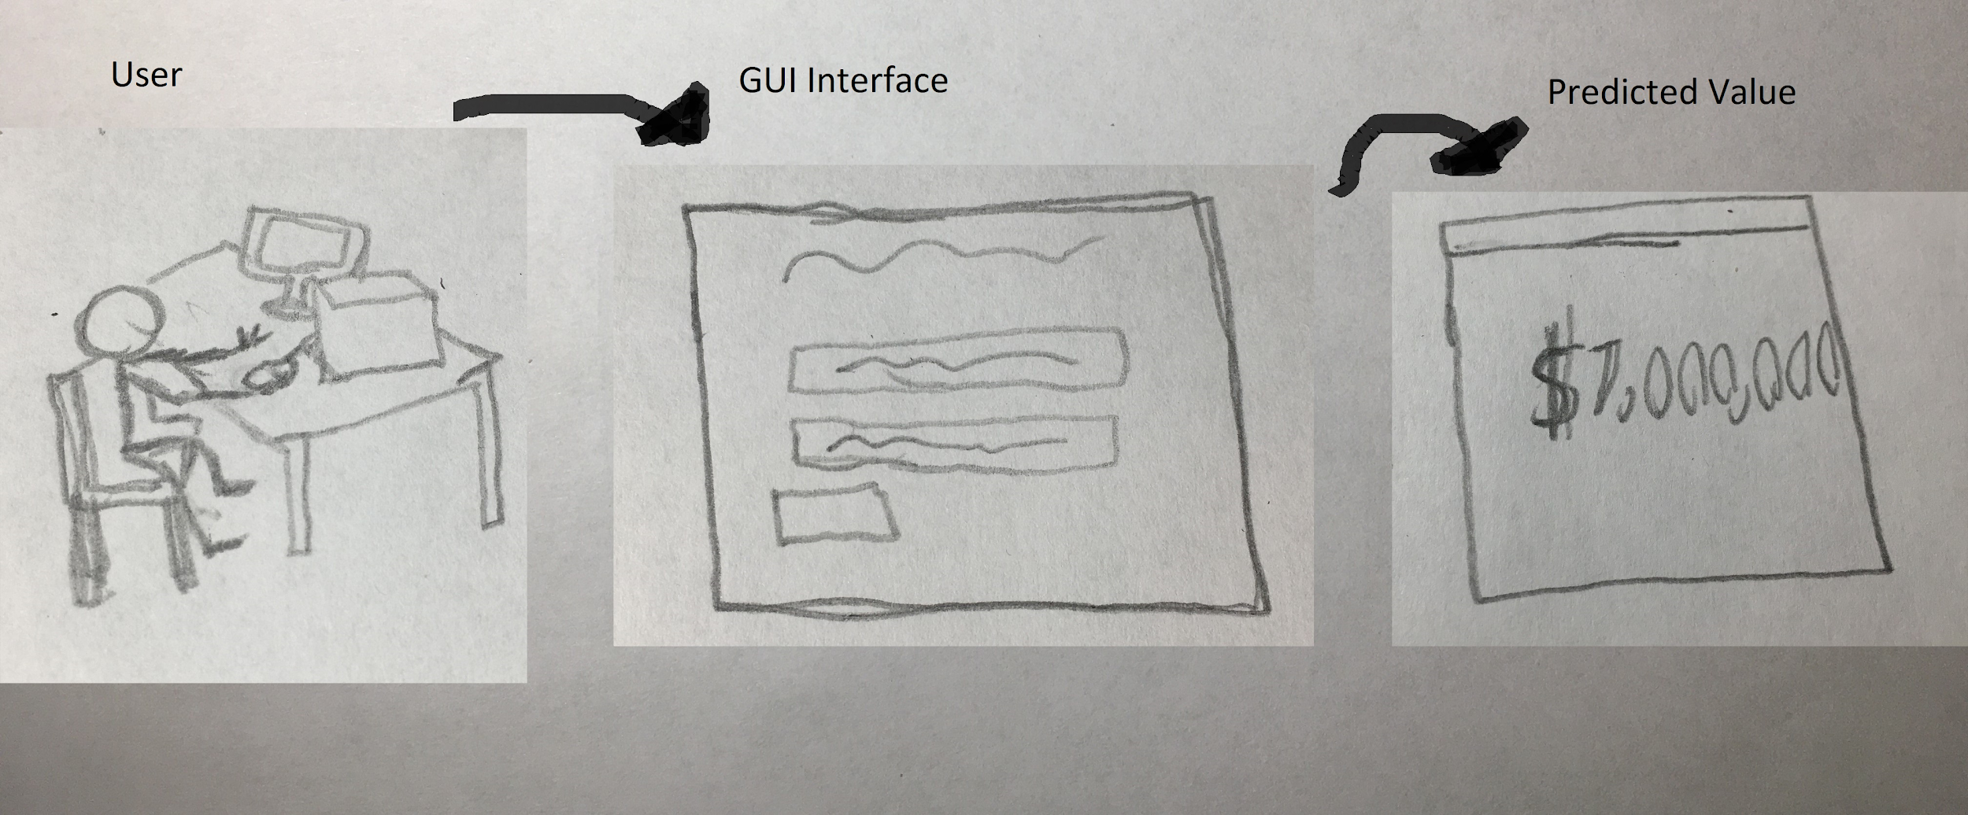
Use Case Diagram

Slide 7
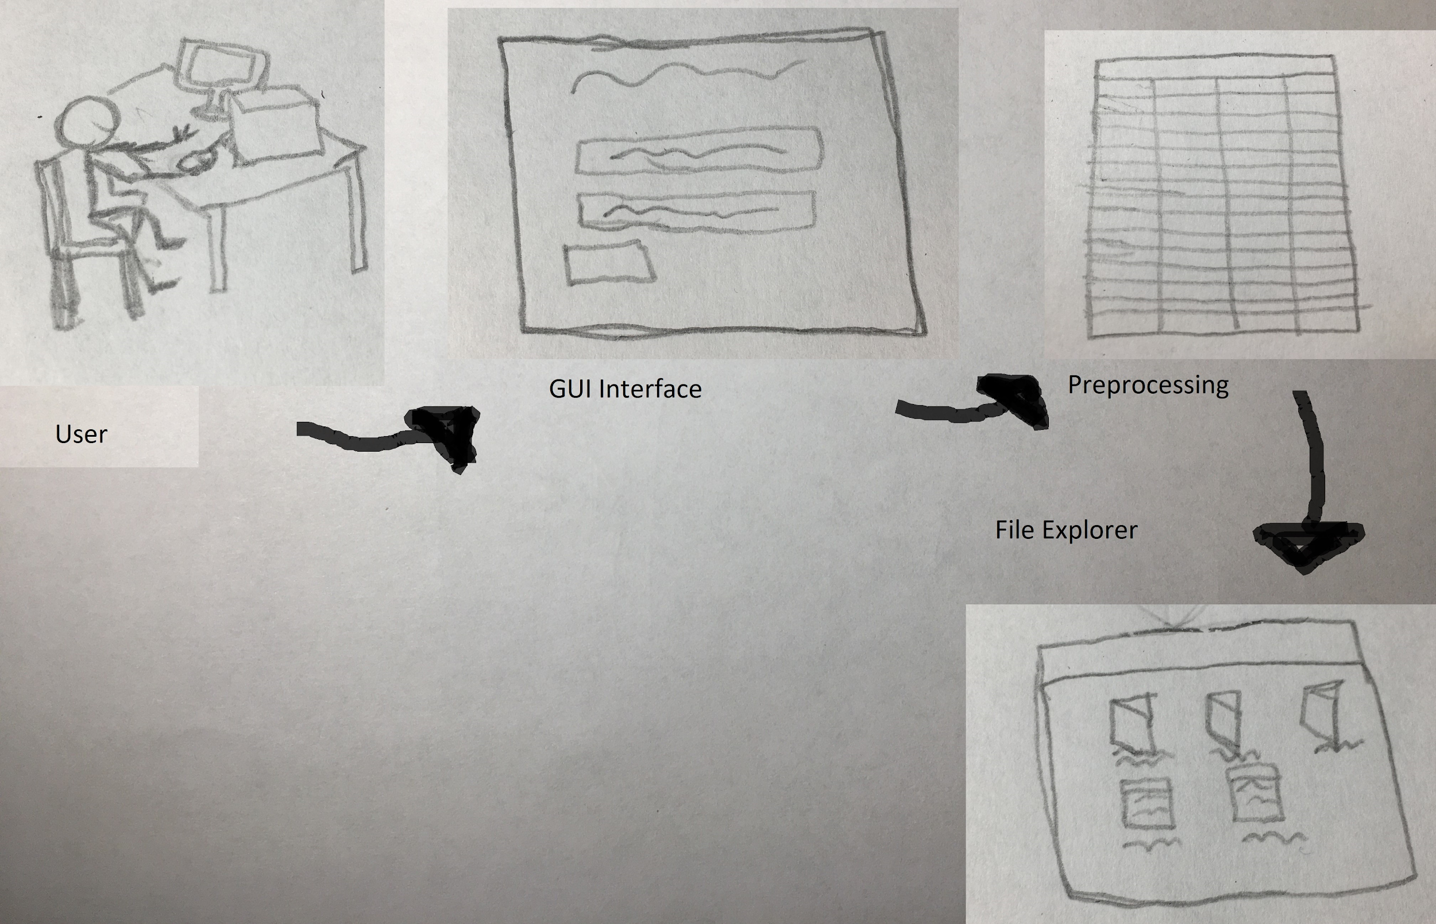
Use Case Diagram

Slide 8
Logistic Regression V. Linear Regression
To be used to identify macro trend in music, and possibly identify usable features for the calculation of ROI.

Slide 9
Regression Models and Relationships
There are multiple regression algorithms that can be used to determine trends, for the sake of this project we have chosen to use many Logistic, Linear, and Decision Tree Regression Models. Factor Analysis was also used but was not a core topic in class so will briefly be touched upon.
When deciding on our dataset and what measurement we wanted to test our original plan was to test the growth of genres over a period of time. This however would have been pretty hard if not impossible with the dataset we chose to instead find the correlation between number of ratings, number of reviews, and the actual ratings for all artist. This allows us to show trends based upon the genres in a more general sense.

Slide 10
Problems we encountered during Log Regression
There were a few problems that we ran into during this project for my portion, the first was ultimately having to give up on trend data as it would've been either too skewed to use if I generalized or too specific as there were 400+ genres within our data set.
The next issue was a graphing issue as trying to include genres into any of the answers would not allow for scatter plots and even without the data had slight issues that forced the use of a heatmap instead of a traditional plot.
Lastly Logistic Regression better with categorical features and not number which made it the worst choice when determining the rating trends.

Slide 11
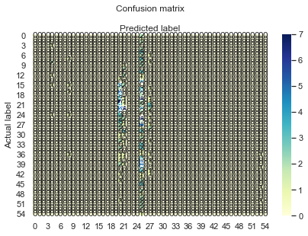
Heatmap and Explanation Logistic Regression
To the left is the heatmap for the number of ratings / number of reviews in correlation with the actual rating.
A heatmap in general shows where things fall on a cnf matrix. The concentration you see to the left shows that in general the number of ratings and reviews is relative to one another to.

Slide 12
Linear Regression and Explanation
Linear Regression was the best choice out of the in class algorithms as it is meant for numerical and binary values. It went well when defining how the number of reviews and ratings affected the overall rating of an album.
The preprocessing for this step is also easier as you can drop all unneeded columns then reshape the last two into the sizes that you need.

Slide 13
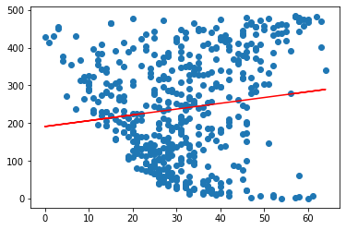
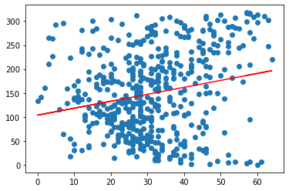
Visualization of Linear Regression
The top graph shows the correlation in the number of ratings vs. the actual rating , and the bottom graph shows the number of reviews vs. the actual rating.
They are both positive which shows they have some correlation, we found that the number of reviews had a higher impact on the actual rating than the number of ratings.

Slide 14
Decision Tree Regression
Model
To be used for calculating the potential revenue of an artist’s album

Slide 15
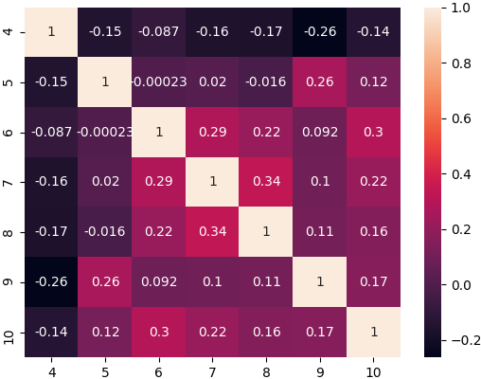
Implementing Decision Regression Trees
Decision Trees are a popular mode of data evaluation and are commonly implemented.
Program aims at predicting the potential revenue of of any artist's album/mixtape. Based on 11 features such as release date, artist name, album name, US billboard position, Uk billboard position etc.
To make sure the many ranking features are significant to predicting the target value, a HeatMap was used to compare the target “indicative revenue” which is renamed to “4” in the figure vs the rankings of the albums in different countries: us, uk de, fr, ca, au, which were converted to 5,6,7,8,9,10 respectively.

Slide 16
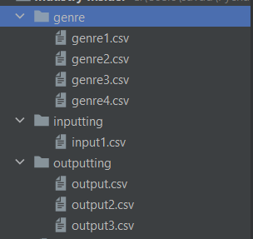
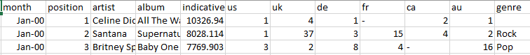
Preprocessing
In addition to predicting the target feature, the Program currently includes a rudimentary dataset creator and preprocessor. Currently it is able to take multiple columns from different csv files, and subsequently combine them into a single one. Lastly it then scans the name of artists in the generated csv file and compares it to another csv file that holds the genres of a multitude of artists, so that the last column “genres” can be added to the dataset. This allows for flexibility in the use of the software, in tandem with the autonomous production of novel datasets.

Slide 17
Problems encountered with Decision Trees
The accuracy of the Decision Tree is simply not where it needs to be it is less than 23% with a 15% error margin.
One iteration to the next has high variance.
One reason may be related to how some features which were originally strings and categorical in nature were encoded.
The features were encoded to numerical values arbitrarily, this can increase the depth of the tree lopsidedly for these categorical string types as the decision tree tries to make sense of what its been given.
In the next attempts "one-hot encoding" will be used on the problematic features, this would create a new column for every value of the original column.
If accuracy improves, a single decision tree model may suffice, if not, other models will be investigated such as Decision Tree in Leave-One-Out, RandomForest.

Slide 18
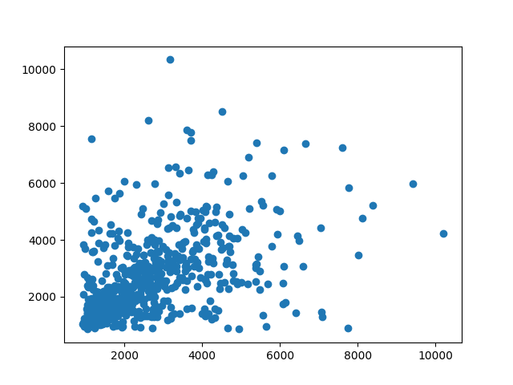
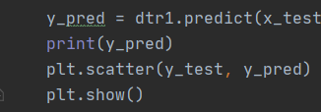
Actual vs Predicted for Decision Tree
The Actual values are on the X axis, the predicted are on the Y axis. Each point represents the Coordinate (Actual, Predicted), a desirable outcome to view would be when the plotted points take the shape of a line From bottom left to top right. I.e when the X is equal or close to the Y value.

Slide 19
The End!

